Slide 1
Federated task-tracking
Background and Ideas
Ponder Source
15 December 2022
Manuel Esménio

Slide 2
Topics
Background
Format Translation
Neighbourhood
Trust
Research questions

Slide 3
Background
Federation
All nodes comply to a set of federation rules.
Each node has authority and sovereignty over its own data.
Data flows from a node to its neighbours.
Nodes are aware of their neighbouring nodes.
Nodes must have at least 2 neighbours.

Slide 4
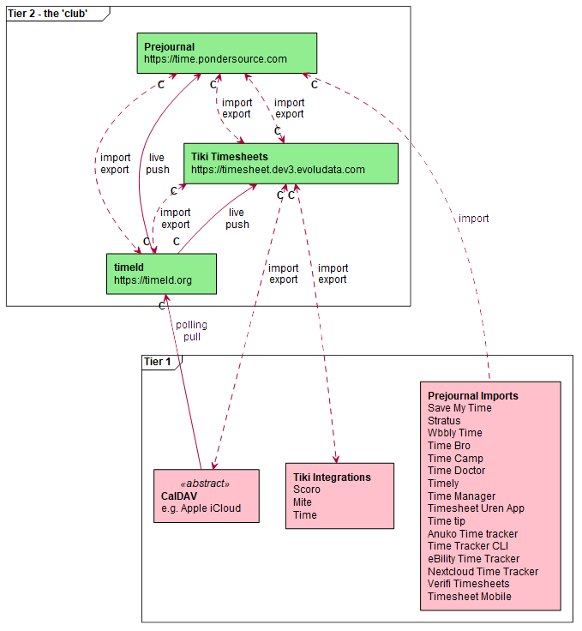
Background

Slide 5
Background
Research questions
How does a node decide to accept data?
Who does a node forward data to?
How does a node settle conflicting data?
How is format translation handled?

Slide 6
Format Translation
Core Ideas
Conversion of data format when transmitting data between neighbouring nodes.
Can imply loss of information.
Tricky to automatize.

Slide 7
Neighbourhood
Core Ideas
Open communication channels between a given node and other nodes in the federation.
Each channel requires a different format translation function.

Slide 8
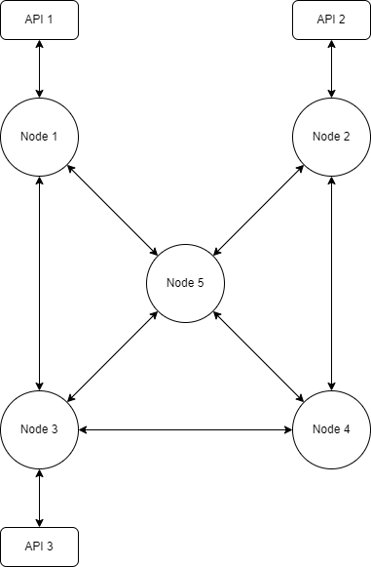
Neighbourhood

Slide 9
Neighbourhood
Data transfer from API 1 to API 2
1 -> 5 -> 2
1 -> 5 ->4 -> 2
1 -> 5 -> 3 -> 4 -> 2
1 -> 3 -> 4 -> 2
1 -> 3 -> 4 -> 5 -> 2
1 -> 3 -> 5 -> 4 -> 2

Slide 10
Trust
Core Ideas
Quantification of how reliable is a communication channel and the data being transmitted.
Only requires a node to know about its neighbours.
Can be used as tool to locally reduce number of transmissions and settle conflicting data.

Slide 11
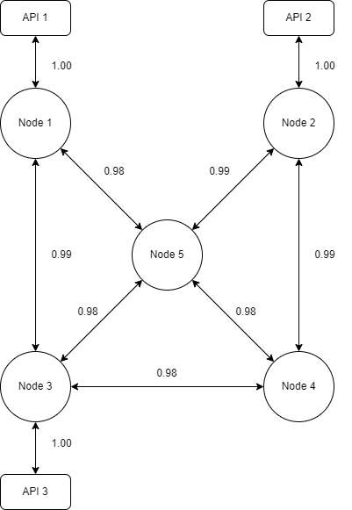
Trust

Slide 12
Trust
Data transfer from API 1 to API 2
1 -> 5 -> 2
1 x 0.98 x 0.99 = 0.9702
1 -> 5 ->4 -> 2
1 x 0.98 x 0.98 x 0.99 = 0.9507
1 -> 5 -> 3 -> 4 -> 2
1 x 0.98 x 0.98 x 0.98 x 0.99 = 0.9318
1 -> 3 -> 4 -> 2
1 x 0.99 x 0.98 x 0.99 = 0.9605
1 -> 3 -> 4 -> 5 -> 2
1 x 0.99 x 0.98 x 0.98 x 0.99 = 0.9413
1 -> 3 -> 5 -> 4 -> 2
1 x 0.99 x 0.98 x 0.98 x 0.99 = 0.9413

Slide 13
Research questions
How does a node decide to accept data?
If for a given data transmission, there is a version stored with higher trust, the transmission is rejected. Else it is accepted. (Can be thresholded)
Who does a node forward data to?
Forwards data to all its neighbours, since the one that aren't interested will reject it (roles can be reversed)

Slide 14
Research questions
How does a node settle conflicting data?
In case of the same transmission presenting different data coming from different routes, the one with highest trust is picked.
How is format translation handled?
I have no idea how to do this other than manually, which results in a cost associated with opening a communication channel.

Slide 15
Research questions
New Questions
How are neighbours picked?
How is trust initialized and updated?
How are versions handled?
Which node has to translate the data (sender/receiver)?

